Slide 1
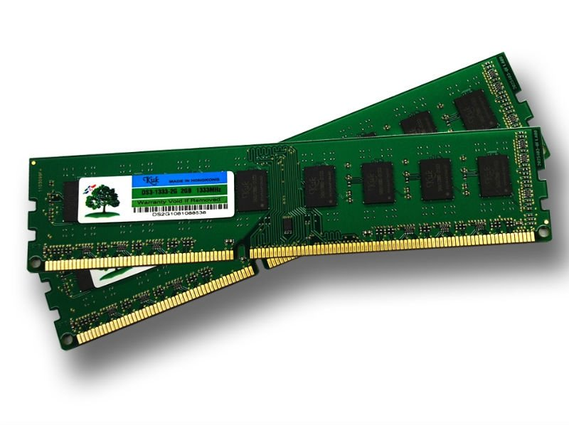

SQL on Hadoop
RAM not Disk
Paul Groom
Notes:
Note: 2 click build
RAM - misunderstood
In an industry hooked on a cute little yellow elephant – lets establish a mental placeholder for the changes to come
Big ram with attitude!

Slide 2


Notes:
Note: 1 click build
If you have trickle of data – time to leave the room
Is this your reality – a hug flow of data?

Slide 3
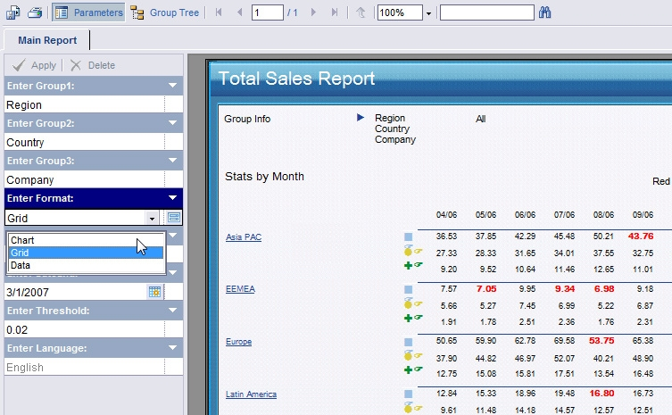
Behind the numbers
create external script LM_PRODUCT_FORECAST environment rsint
receives ( SALEDATE DATE, DOW INTEGER, ROW_ID INTEGER, PRODNO INTEGER, DAILYSALES INTEGER )
partition by PRODNO order by PRODNO, ROW_ID
sends ( R_OUTPUT varchar )
isolate partitions
script S'endofr( # Simple R script to run a linear fit on daily sales
prod1<-read.csv(file=file("stdin"), header=FALSE,row.names=1)
colnames(prod1)<-c("DOW","ID","PRODNO","DAILYSALES")
dim1<-dim(prod1)
daily1<-aggregate(prod1$DAILYSALES, list(DOW = prod1$DOW), median)
daily1[,2]<-daily1[,2]/sum(daily1[,2])
basesales<-array(0,c(dim1[1],2))
basesales[,1]<-prod1$ID
basesales[,2]<-(prod1$DAILYSALES/daily1[prod1$DOW+1,2])
colnames(basesales)<-c("ID","BASESALES")
fit1=lm(BASESALES ~ ID,as.data.frame(basesales))
forecast<-array(0,c(dim1[1]+28,4))
colnames(forecast)<-c("ID","ACTUAL","PREDICTED","RESIDUALS")
select sum(sales)
from sales_history
where year = 2006 and month = 5 and region=1;
select total_sales
from summary
where year = 2006 and month = 5 and region=1;
select Trans_Year, Num_Trans,
count(distinct Account_ID) Num_Accts,
sum(count( distinct Account_ID)) over (partition by Trans_Year order by Num_Trans) Total_Accts,
cast(sum(total_spend)/1000 as int) Total_Spend,
cast(sum(total_spend)/1000 as int) / count(distinct Account_ID) Avg_Yearly_Spend,
rank() over (partition by Trans_Year order by count(distinct Account_ID) desc) Rank_by_Num_Accts,
rank() over (partition by Trans_Year order by sum(total_spend) desc) Rank_by_Total_Spend
from( select Account_ID,
Extract(Year from Effective_Date) Trans_Year,
count(Transaction_ID) Num_Trans,
sum(Transaction_Amount) Total_Spend,
avg(Transaction_Amount) Avg_Spend
from Transaction_fact
where extract(year from Effective_Date)<2009
and Trans_Type='D'
and Account_ID<>9025011
and actionid in (select actionid from DEMO_FS.V_FIN_actions
where actionoriginid =1)
group by Account_ID, Extract(Year from Effective_Date)
) Acc_Summary
group by Trans_Year, Num_Trans
order by Trans_Year desc, Num_Trans;
select dept, sum(sales)
from sales_fact
Where period between date ‘01-05-2006’ and date ‘31-05-2006’
group by dept
having sum(sales) > 50000;
Notes:
Note: 1-Click Build
Is this increasing complexity of query your problem?
BI mostly focuses (sells) on presentation – Graphics, pictures, Visualisation
BUT behind the scenes a lot of heavy lifting has to be done
This workload has changed over time from the simple to complex

Slide 4

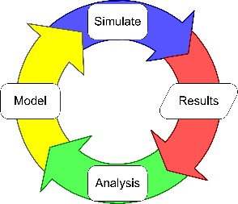
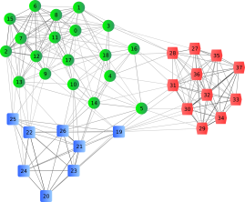
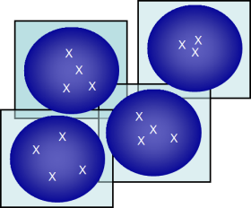
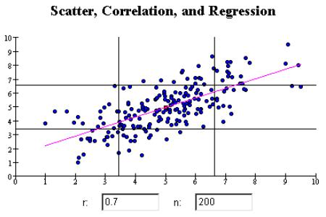
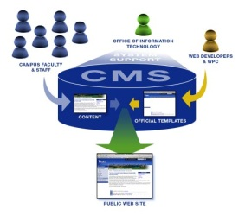
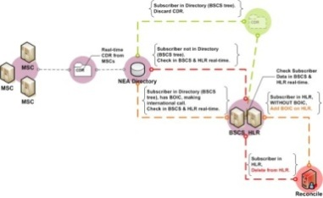
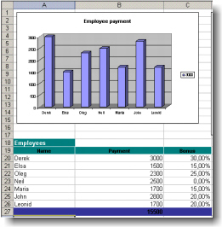
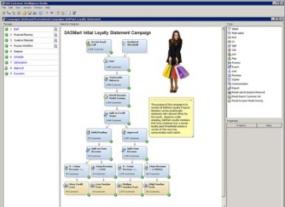
Faster, deeper, insight
Machine learning algorithms
Behaviour modelling
Dynamic
Simulation
Analytical Complexity
Statistical Analysis
Clustering
Dynamic Interaction
Fraud detection
Reporting & BPM
Campaign Management
Technology/Automation
Notes:
No Build
Do your users aspire to more than just simple reports?
Richer more complex low latency analytics
Lots of applications utilise SQL to get their data and run complex queries
Evaluating, clustering, Scoring – on the fly
No longer background low frequency but foreground high frequency
Machine learning – fraud detection/gaming
Web Analytics – Dynamic content/bid management
Modelling – traditional clustering/behavioural for marketing/product development/resource optimisation
Investigative Reporting (Dashboards and reports with granular data access)
Data Model

Slide 5



Notes:
Note: 2 click build
Is this the scale of user community?
- Lucky you – I’d watch the one on the left – looks like trouble
Or is reality more like this – lots of users
Or more like this bunch – they think it should all be one click away…why…

Slide 6

Notes:
Have your users been subtly brainwashed by this
Innocuous high performance little box?

Slide 7

Time to influence
Reaction – what? – potential value
Action – opportunity - interaction
BI is becoming democratized
Notes:
Note: no build
But most importantly – is there a time imperative?
Time to deliver
Latency in process
SLAs to meet
Volumes to support in operational windows
- time ‘needed’ to influence – reaction - what
- the time ‘now ‘to influence – action – opportunity
Two contexts
- time to influence peers and managers
- time to influence customers

Slide 8



Innovate
Consolidate
Notes:
Note: Progressive build, then 1 click change
Exciting times
Industry cyclic behaviour – definitely in the innovate phase at present – lots of tech disruption
Lightbulb – innovation - Europe only allows low energy bulbs
JOKE: “How many hadoop engineers does it take to change a lightbulb?”
none as there are at least 2 other redundant light bulbs and we’ll add a new section of ceiling if you need more light
Castle good icon for consolidation
But sand castles are only castles built these days!
Same plight for Data warehouses with Hadoop disruption

Slide 9



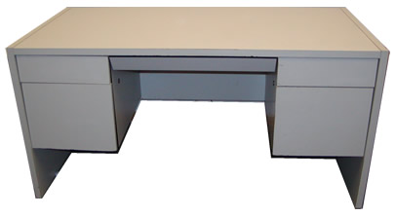
I need….
Notes:
Note: 2 click build
OK lets talk about Jeff he has to innovate.
We hear at conferences about hoodies and suits – I don’t see many of either in this room.
Jeff is a data person – head of BI, head of analytics, CIO – pick a title but data dominates his thoughts, in fact getting value from data dominates his thoughts.
Jeff has a suit in his life – Jeff I want to improve sales, grow revenue, make things more efficient, make our customer happier

Slide 10








Data Discovery tools
Dynamic access
Drill unlimited
Notes:
Note: no build
Common factor SQL
Lots of great tools – Note these are BUSINESS tools
Not just HADOOP tools – used ACROSS the business
Business tools rather than Hadoop tools – existing investment
Plugs into traditional DB, DW etc.
NOTE That: Platfora, Datameer, Hadapt are only Hadoop centric.
Visokio – omniscope
Datawatch - panopticon
New players like Domo, changing players like Alteryx

Slide 11

Business [Intelligence] Desires
More timely
Lower latency
Richer data model
More granularity
More users
interactions
Self service
Notes:
Note: 1 click build of text
Its rarely about more charts, more colours, more report styles
Lower latency – speed of access to new data - real time access
More timely also ‘faster’
where’s the value – in the data and in the access
Build and they will come – its more about interactions per user than raw users (concurrency debate)

Slide 12

Notes:
Note: no Build
Enter Hadoop – takes on the big data challenge
Introduces a new economic model

Slide 13
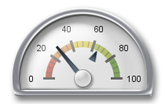
“What percentage of business pertinent data is in your Hadoop today?”
How will you improve that percentage?”
Notes:
Note: no Build
If you are at this event
you own,
want to own
or have been told own a Hadoop implementation!

Slide 14
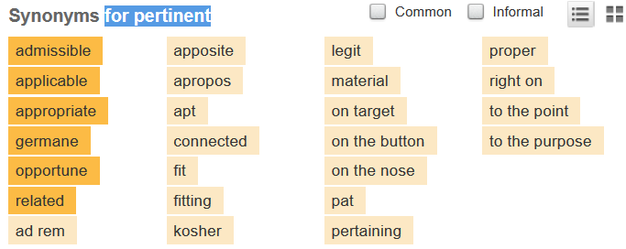
Notes:
Note: no Build
What is pertinence – lots of synonyms
http://thesaurus.com/browse/pertinent

Slide 15
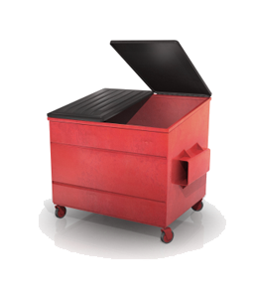
data
But… Are you just Hadumping?
Oliver Ratzesberger @ratesberger
Too much talk about #Hadoop being the end of ETL and then turned into the corporate #BigData dumpster.
8:40 PM - 12 Mar 13
Merv Adrian @merv
@ratesberger mindless #Hadumping is IT's equivalent of fast food - and just as well-balanced. Forethought and planning still matter. 8:43 PM - 12 Mar 13
Notes:
Note: Auto build (no click)
Grabbing, holding
Planning – to drive value to improve pertinence!

Slide 16


Enterprise Integration
Value
Data
Data Lake
Investigative effort
Awareness &
Structured Access
Planning
Hadumping
Notes:
What is difference between hadumping and data lake – serenity and desirability
See the ripple that’s the business sticking a toe into the lake!
Enterprise integration is goal – remember pertinence – but just not for the few for the masses!
Its only meaningful if value is derived

Slide 17

So… engage with that data
Notes:
Note: No build, next slide swipes over
“Investigative effort” – requires action to enagage with data

Slide 18

still
…but Hadoop too slow
for interactive BI
…loss of train-of-thought
Notes:
1-Click Build
Sorry – even with 2.0 and YARN – there is a long way to go
Train-of-thought, drag-and-drop, google effect
Remember the rise of data discovery
Fine for big trawls
Not good for low latency iterations, high frequency access
There, I have dared to say it!
Does not accelerate BI quite in the way business was sold by the EDW
Loss of “interactivity”
A decade of being sold train-of-thought
Hadoop - Not hands on, not desktop, not agile

Slide 19



Business [Intelligence] Desires in relation to Big Data
More timely
Lower latency
Richer data model
More granularity
More users
interactions
Self service
Notes:
Note: Auto Build
So a quick check point – where are we
More timely – no – too much effort to work out what to do?
Batch processing gets in the way of interactive access
Self-serve if you are knowledgeable enough
Winning in some areas but not in all

Slide 20

more math
Complex Analytics & Data Science
…a lot more math
Notes:
Note: 1 click progressive build
Remember the point about innovation – well BI is being rapidly pushed/dragged into
Complex analytics and Data Science

Slide 21
It’s all about getting work done
Bottlenecks
Tasks evolving:
Used to be simple fetch of value
Then dynamic aggregation
Now complex algorithms!
Bottlenecks
Notes:
Note: 1 click build
What the business cares about is getting work done
DW is now a bottleneck – its rigour and model get in the way!
They really don’t care about how it is stored or where it is stored!
Its not about raw individual speed
its about throughput
Address the bottlenecks
Too many vendors play games that just shift the bottleneck

Slide 22



Must get more out of Hadoop!
Need better SQL integration
Notes:
Note: 2 click Build
Back to Jeff – ready to swim in the data lake – the value is in their somewhere
Jeff wants to exploit existing business software stacks not rebuild from scratch

Slide 23
SQL support
…degrees of
BI Users want a lot more than just ANSI ‘89 or ’92 support
What about ‘99, 2003, 2006, 2008 and now 2011?
What about ad-hoc, on-demand now…not batch!
Notes:
Note: 1 click progressive build
SQL is so old – no trendy mascot or logo
Uterly embedded

Slide 24

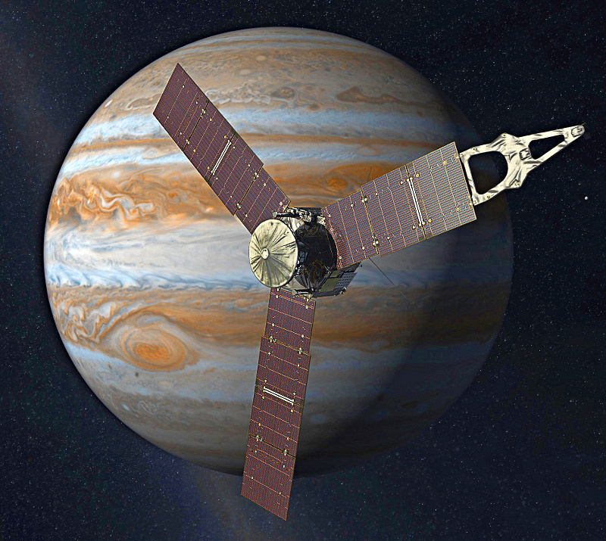
SQL performance
…degrees of
Notes:
Note: No Build
NASA Juno space probe that will study Jupiter
Recent earth slingshot made it fastest man-made object ever - 25miles/sec

Slide 25

Notes:
Note: no build
So in the hallowed computer halls – all that latent power
[Google NC Data Center]

Slide 26

Are you thinking about lots of these?
Notes:
Note: No build – transition to next
That’s just your data dumpster – the store, its passive
Stop thinking storage and start think analyzing

Slide 27
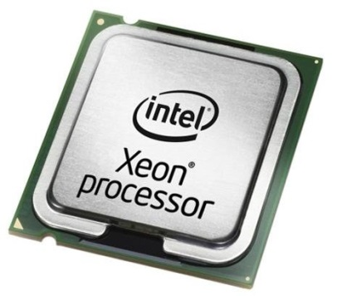
When you should be thinking about lots of these?
Notes:
Note: no build
Confusion about in-memory – its cores dummy!
CPUs do the work – they can do continuous work if fed quickly enough
They reshape data, filter data, summarize and compute
They help find and shape pertinent data
Good parallelism

Slide 28
Problem
Notes:
Note: no build
Too far apart
CPU is hungry
CPUs are available on mass so get them working on the compute requirements
Processor barely idling waiting for data
What sits between them

Slide 29
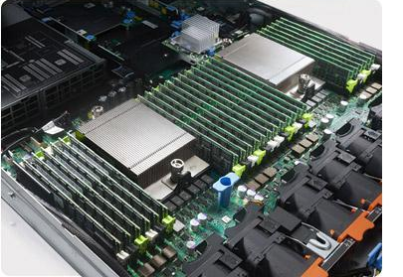
RAM
Notes:
Note: 1 Click build, delayed overlay
Ram picture then overlay
Dell PowerEdge R620 rack server
With lots of RAM

Slide 30
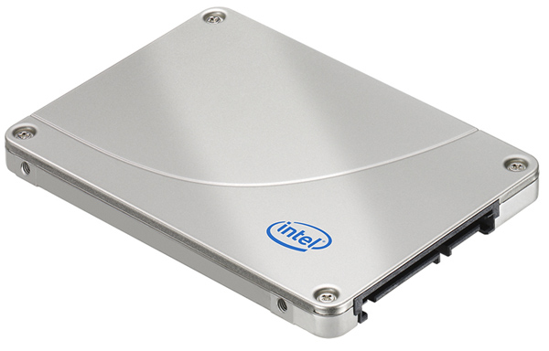
Let’s talk about: Flash is not RAM
Notes:
Note: 2 click build
SSDs great for Random I/O not so good for sequential scanning
Still page based access and disk controller access mechanism

Slide 31
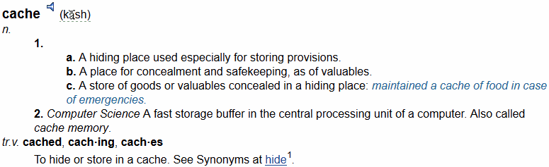

Let’s talk about: in-memory V cache
Notes:
Note: 1 click build ***Key Point *****
Another misunderstood word!
Cache is optimistic – its B+ trying hard
Not deterministic
Still requires a lot of code to “say is data in cache, copy to main memory, then use”

Slide 32

In-memory misunderstood
DRAM
select count(*) from T1;
mov ebx, base(T1)
mov ecx, num
top:
mov eax, const
cmp eax, *ebx
jne next
inc count
next:
add ebx, len(row)
loop ecx, top
Dynamic
Random
Access
Notes:
Note: 2 click build ***Key Point *****
Even analyst community has taken time to catch-up
No code to check cache or request I/O – just code to access data
That’s in-memory processing

Slide 33

Let’s talk about: scale-out V scale-up
Larger RAM few cores does not help
Scale-out with consistent
RAM-to-Core ratio
memory
Notes:
Note: 2 click build ***Key Point *****
SMP and NUMA - Noooooooo! - HP Kraken - to help SAP
Its not about making huge RAM - need to scale controllers and CPUs
Scale out MPP in-memory is hard!
Same message as Hadoop platform itself
- scale out on commodity platform
- others struggle

Slide 34
13 We fetch rows back into an internal interpreter structure.
14 We drop the temporary table TT2.
15 We prepare the interpreter to execute another query.
16 We get values from a lookup table to prequalify the loading of
EDW_RESPD_EXPSR_QHR_FACT. This is performed by the following steps, up
to 'We fetch rows back into an internal interpreter structure'.
17 We create an empty temporary table TT3 in RAM which will be randomly
distributed.
18 We select rows from the replicated table EDW_SRVC_MKT_SEG_DIM(6490) with
local conditions applied. From these rows, a result set will be
generated containing 2 columns. The results will be inserted into the
randomly distributed temporary table TT3 in RAM only. Approximately 14
rows will be in the result set with an estimated cost of 0.011.
19 We select rows from the randomly distributed temporary table TT3. From
these rows, a result set will be generated containing 1 column. The
results will be prepared to be fetched by the interpreter.
Approximately 14 rows will be in the result set with an estimated cost
of 0.023.
20 We fetch rows back into an internal interpreter structure.
21 We drop the temporary table TT3.
22 We prepare the interpreter to execute another query.
23 We create an empty temporary table TT4 in RAM which will be randomly
distributed.
24 We select 6 columns from disk table EDW_RESPD_EXPSR_QHR_FACT(6501) with
local conditions. The results are inserted into the randomly
distributed temporary table TT4. The result set will contain
Optimizer
Optimize

Slide 35
Good News: The Price of RAM
Price of RAM (Log10)
1987
1995
2000
2005
2010
Notes:
Note: 1 click build
Lets revisit cash quickly – price of RAM has plummeted

Slide 36
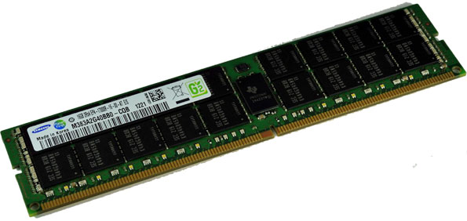
DDR4
Greater throughput to feed more CPU cores
…and thus do more analysis
Notes:
Note: 1 click build
Innovation – faster – but like the bulb lower energy cost!
DDR4 now in mass production
Faster clock frequencies and data transfer rates (2133–4266 MT/s compared to DDR3's 800 to 2133 MT/s^{[6][7][8]})
2,667 Mb/s
16GB double data rate-4 (DDR4), registered dual inline memory modules (RDIMMs), which at the outset are designed for use in enterprise class servers.
and it's expected to reach twice the current 1,600Mbps throughput of DDR3 - plus lower power (30-40% reduction)

Slide 37
Pertinence comes through analytics;
Analytics comes through processing
…and not just occasional batch runs.
So leave no core idling – query from RAM
Notes:
Note: no Build

Slide 38
So remember in-memory is about lots of these?
Notes:
Note: no build
Confusion about in-memory – its cores dummy!
CPUs do the work – they can do continuous work if fed quickly enough
They reshape data, filter data, summarize and compute
They help find and shape pertinent data
Good parallelism

Slide 39
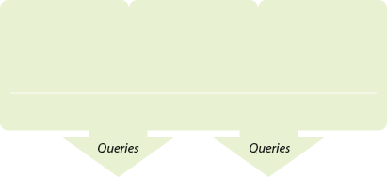
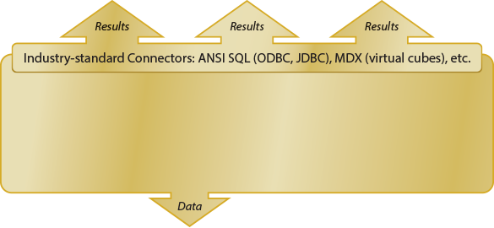
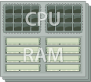
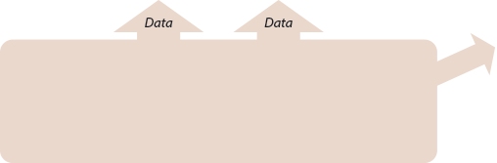

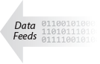
Business Integration - Analytical Platform
Application &
Client Layer
All BI Tools
All OLAP Clients
Excel
Analytical
Platform
Layer
Near-line
Storage
(optional)
Reporting
Persistence
Layer
Kognitio
Storage
Hadoop Clusters
Cloud Storage
Enterprise Data
Warehouses
Legacy
Systems
Notes:
Note: no Build
SQL on Hadoop and on DW and on cloud
Must also be inclusive
Hadoop is not the only store of data
Don’t forget the cloud
Don’t forget the DW and surrounding marts
Don’t forget the operational systems

Slide 40
Building corporate information architecture “Information Anywhere”:
Acquire all data
Structured Hadoop repository
In-memory analytical platform
Business Intelligence tools
Analytical tools
Functional SQL interconnects
Building blocks for information discovery and extraction
Notes:
Note: 1 Click Build
Jeff – will be happy – less headaches
No plethora of components and tech
- plug and play
- hey just like his SQL database
Focus on the data and data quality
And information extraction – data pertinence

Slide 41
Epilogue
Notes:
Remember old TV programmes - Epilogue

Slide 42
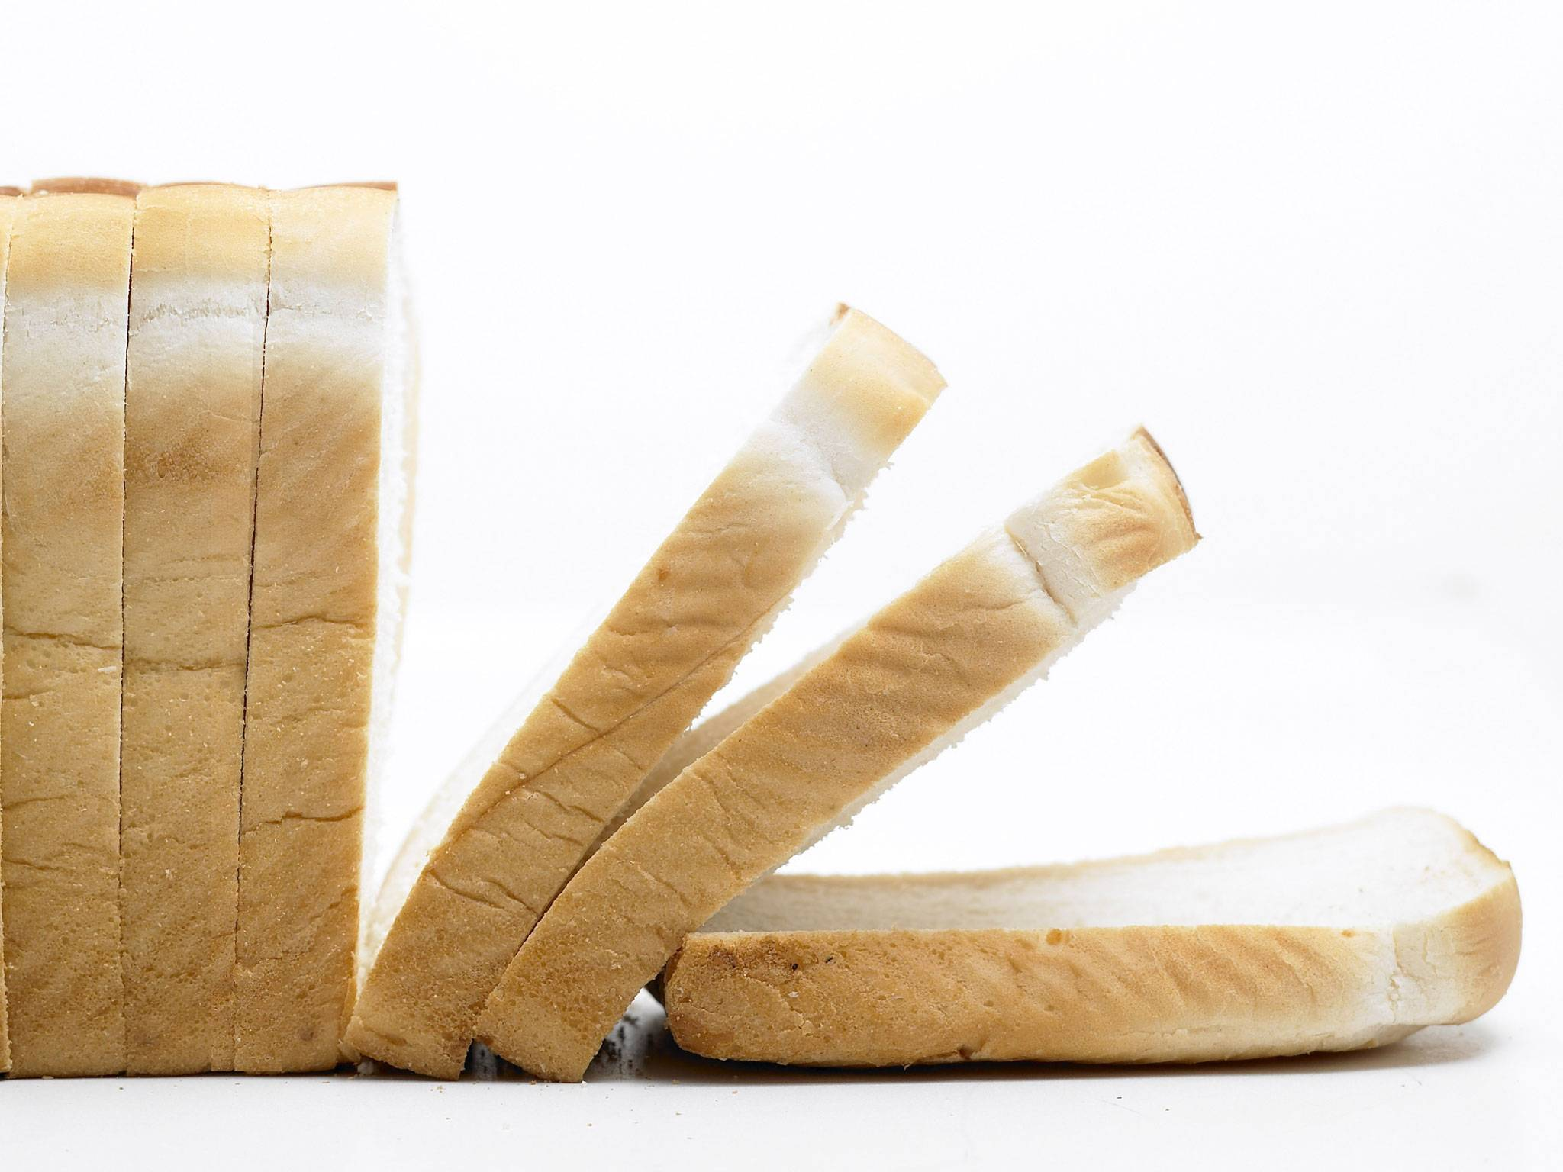
Inevitable commoditization
Notes:
Note: No Build
Where Hadoop is headed
The openness and accessibility.
It already runs on a commodity platform!
Every refinement in functionality and provisioning makes Hadoop more commoditized.
Only a few major suppliers but must operate to the open standards of functionality.
Every program that does code generation eliminates need for programmers.
No one has the Oracle or Teradata market capture and licence model to make a fortune.

Slide 43
“vendors always commoditize storage platforms …again and again”
In 2013 Kinetic hard drives first launched
Direct access over Ethernet
Direct object access via key value pairs
The HDFS versions followed a few years later …now map-reduce going into firmware?
Notes:
Notes: 2 click build
Industry already pushing down into components
Seagate – Terascale drives – functional network device
Data centric access – key store commoditised platform
What about AWS? – cloud based commoditization
http://forums.theregister.co.uk/forum/1/2013/10/23/seagate_terascale_is_first_kinetic_drive/

Slide 44
Innovate
Consolidate
Notes:
Note: no build
Industry cyclic behaviour will soon cycle back to Consolidation
Rationalise computing real-estate, consolidate applications and services,
Hadoop is exciting now but Its eclectic and fiddly which requires knowledge and skill to traverse
great for programmers, not so great for business
Every step forward is step towards commoditization
Hadoop is the not the “be all and end all”
lots of other data platforms

Slide 45




connect
contact
kognitio.com
Paul Groom
Chief Innovation Officer
paul.groom@kognitio.com
kognitio.tel
kognitio.com/blog
Michael Hiskey
VP, Marketing & Business Development
michael.hiskey@kognitio.com
twitter.com/kognitio
linkedin.com/companies/kognitio
tinyurl.com/kognitio
Steve Friedberg - press contact
MMI Communications
steve@mmicomm.com
youtube.com/kognitio
Kognitio is an Exabyte Sponsor of Strata Hadoop World – see us at booth #409
Notes:
Kognitio

